Slide 1


Baroda Institute of Technology
Data Analysis using
MySQL
Air Quality Index
Presented by
Puja Sadafal

Slide 2

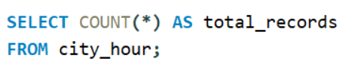
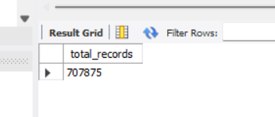
1.What is the total number of records in the AQI Dataset?
Output:-

Slide 3
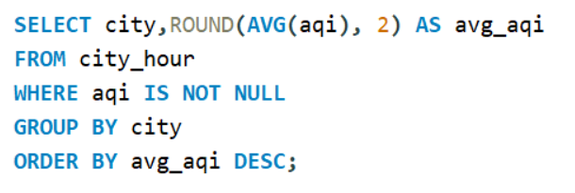
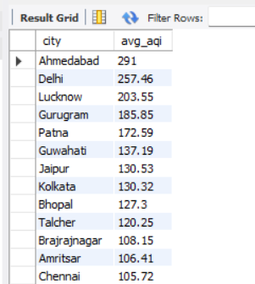
2.What is the average AQI value for each city?
Output:-

Slide 4
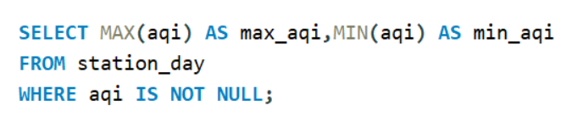
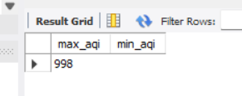
3.What is the maximum and minimum AQI recorded in the Dataset?
Output:-

Slide 5
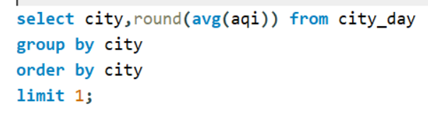
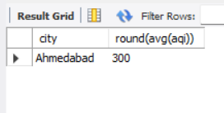
4.Which city has the highest average AQI?
Output:-

Slide 6
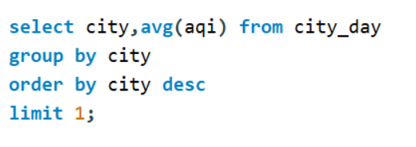
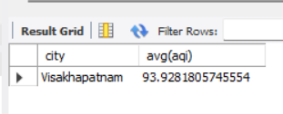
5.Which city has the lowest average AQI?
Output:-

Slide 7
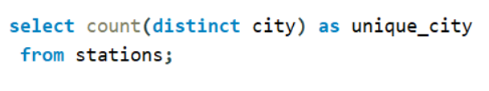

6.How many unique cities are included in the AQI Dataset?
Output:-

Slide 8
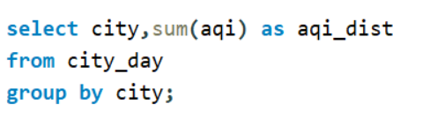
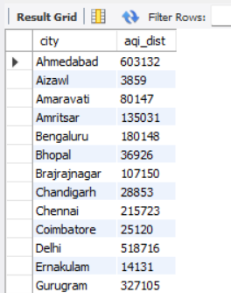
7.What is the distribution of AQI values for each city (using city as group)?
Output:-

Slide 9
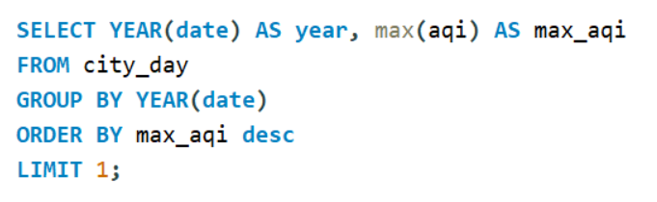
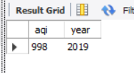
8.Which year has the highest recorded AQI?
Output:-

Slide 10
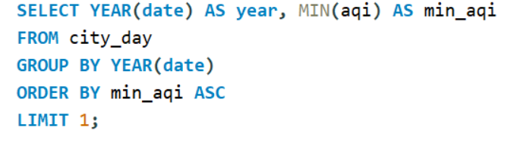
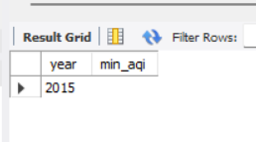
9.Which year has the lowest recorded AQI?
Output:-

Slide 11
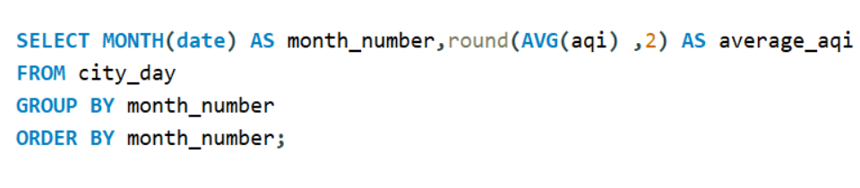
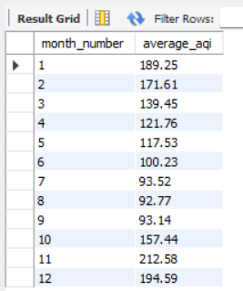
10.What is the average AQI for each month across all years?
Output:-

Slide 12
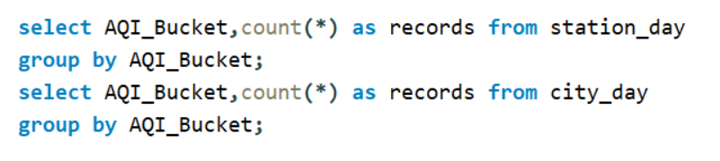
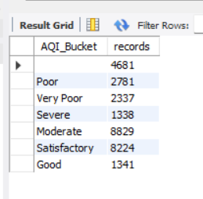
11.What is the total number of records for each air quality category(e.g., Good, Moderate, Unhealthy)?
Output:-

Slide 13
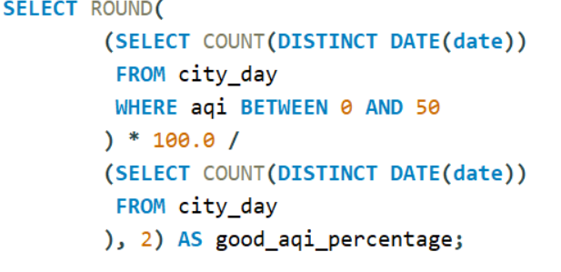
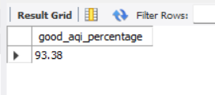
12.What is the percentage of days that have a
“Good” AQI across all cities?
Output:-

Slide 14
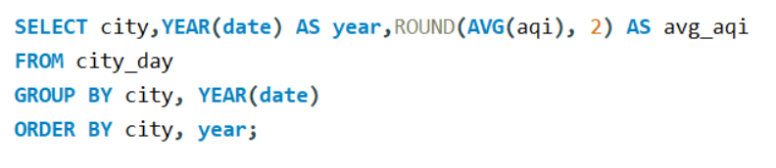
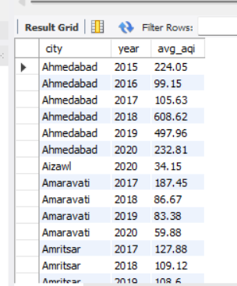
13.How does the AQI change on a yearly basis for each city?
Output:-

Slide 15
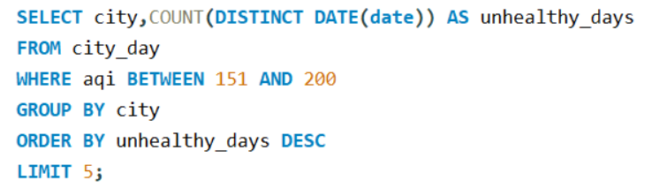
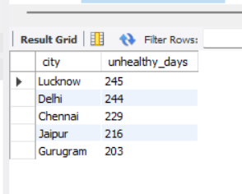
14.What are the top 5 cities with the most days of “Unhealthy” AQI?
Output:-

Slide 16
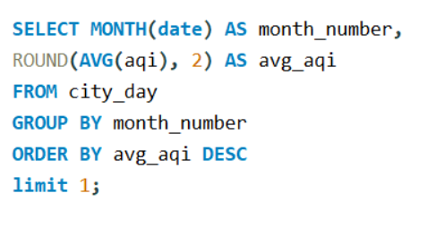
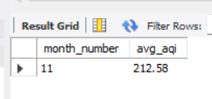
15.Which months tend to have the worst air quality on average?
Output:-

Slide 17
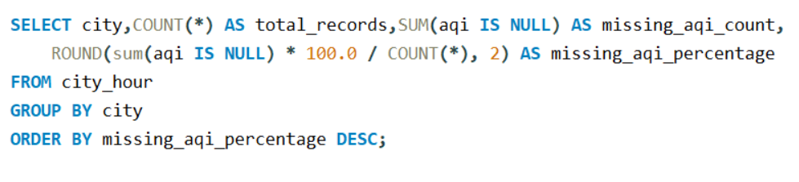
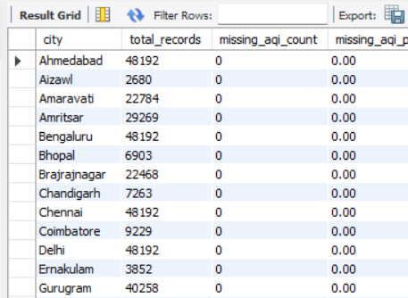
16.What is the percentage of missing AQI data per city?
Output:-

Slide 18
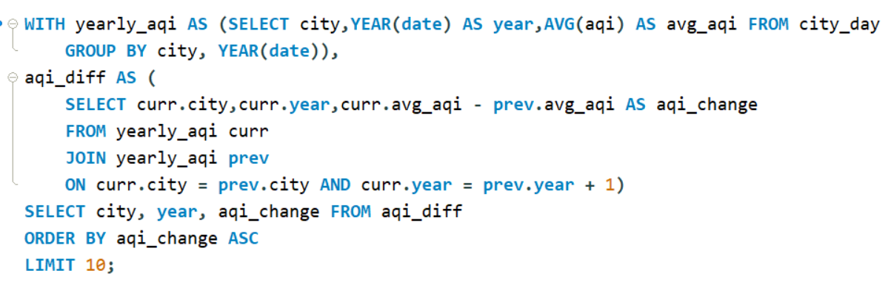
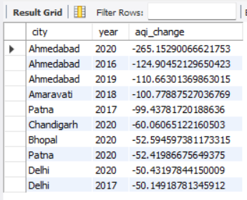
17.Find the city where aqi shows the most improvement (lower Aqi )from the previous year?
Output:-

Slide 19
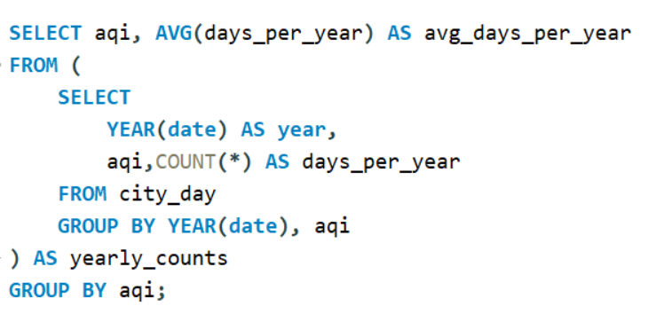
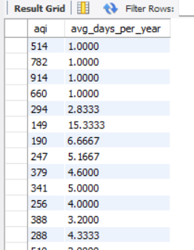
18.For each air quality level, what is the average number of days that fall into each category in a year?
Output:-

Slide 20
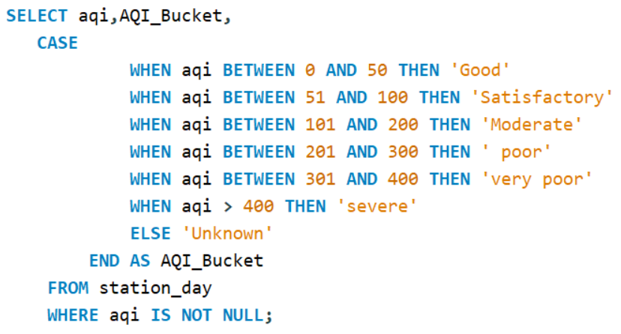
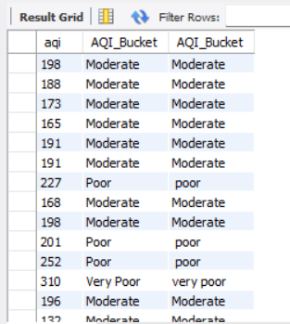
19.What is the distribution of AQI values for each air quality level(e.g., Good, Moderate, Unhealthy)?
Output:-

Slide 21
Thank you

